Slide 1
How Do Committees Invent?
By Melvin E. Conway, Datamation, April 1968
Presenter: Baran Kaya
Notes:
I'm going to present the "How Do Committees Invent" paper by Melvin E. Conway.
He published this paper in Datamation computer magazine in April 1968.

Slide 2

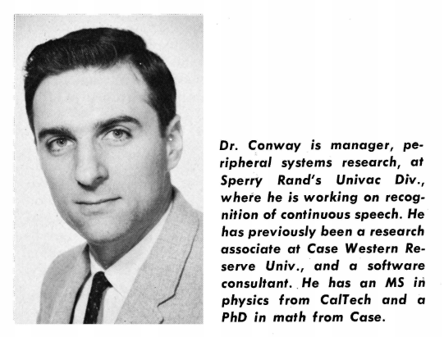
Who is Melvin Conway?
Computer scientist, programmer
B.S. Physics, Case
M.S. Physics, Caltech
Ph.D. Math, Case
Compilers and assemblers
Conway’s Law
Notes:
Who is Melvin Conway?
He is a computer scientist and a programmer
He has BS and MS degrees in Physics
And Ph.D in Math form case university
He worked on compilers and assemblers
But he mostly famous for Conway's Law

Slide 3
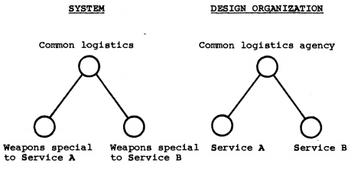
Conway’s Law
“Organizations which design systems are constrained to produce designs which are copies of the communication structures of these organizations.”
Notes:
What is Conway's law? (Does anybody know, other than paper reviewers?)
Conway's Law states that “Organizations which design systems are constrained to produce designs which are copies of the communication structures of these organizations.”
Basically if the organization communication structure looks like this, their project design will look like this one. This diagram is in paper and it shows a military hierarchy and its design.

Slide 4

Design of a System
Creative actions to build anything
with a distinct subsections/subsystems.
Major weapon system
Mechanical components
Computer programs
Notes:
- Design of a system is Creative actions to build anything with a distinct subsections (subsystems).
These can be
a major weapon system,
a mechanical component
or a computer programs
- General design actions are mostly the same.

Slide 5


System Design
Creation and assembly
Document with structured info
Information → System design
Sponsor
Notes:
Design organizations’ objective is creating a document that contains a coherently structured information.
This information is called the system design.
The organization who designed the product may not be the manufacturer of the product.
In that case they create the design for a sponsor.
And sponsors affect the design choices.

Slide 6

Stages of Design
Primary stages → Managing design activities
Milestones:
Learning the limits of design actions and the limits of the system. System limits can be caused by the world or the sponsor.
Dividing the design tasks into parts and assigning these parts to relevant groups.
Organization communication paths can change designs
Notes:
Stages of design
Primary stages of the design is managing the design actions rather than system design.
There are two milestones for this:
Learning the limits of design actions and the system. System limits can be caused by the world or the sponsor
2. Dividing the design tasks into parts and assigning these parts to relevant groups.
- Because of the organization communication paths some design choices eliminated.

Slide 7

The Lifecycle of the System Design
Determining boundaries according to the guidelines.
Choosing the first system concept.
Organizing the design activity and assigning tasks according to the concept.
Coordinating delegated tasks.
Merging sub designs into a single design.
Notes:
The lifecycle of the system design
Determining boundaries according to the guidelines.
Choosing the first system concept.
Organizing the design activity and assigning tasks according to the concept.
Coordinating delegated tasks.
Merging sub designs into a single design.
- This list or its order can change with a better design concepts.

Slide 8

The Designed System
A system consists of interconnected subsystems.
System
Connection to inside
Connection to outside
For each subsystem
Define subsystems’ interconnections
Lower scope → until simple system
Notes:
A designed system consists of interconnected subsystems.
System description should contain connections to inside and outside.
Same goes for each subsystem.
That means it has to define subsystems’ interconnections.
We can lower the scope until a system that simple enough to figure out without splitting it.

Slide 9

Transcontinental Public Transportation System
Notes:
For example we want to build a Transcontinental Public Transportation System.
We need to start from its subsystems.
Can you give me an example subsystem?

Slide 10






Buses, Airplanes, Trains, Taxis, Terminals, Stops, Parking lots, …
Notes:
This system consists of…
This is very heterogeneous system because subsystems are quite diverse.
Now we can look one of these systems subsystems.

Slide 11
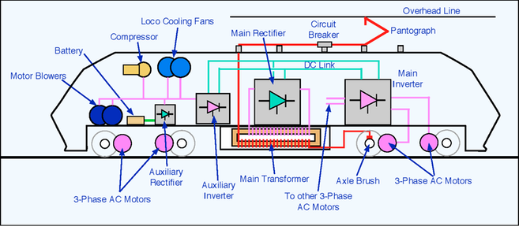
Train Subsystems
Structure
Engine
Power distribution
Communication
Seating plan
Notes:
Train has structure, engine, power distribution, communication, seating plan subsystems…
And some of them has their own subsystems.

Slide 12
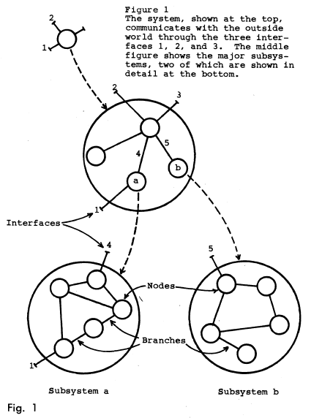
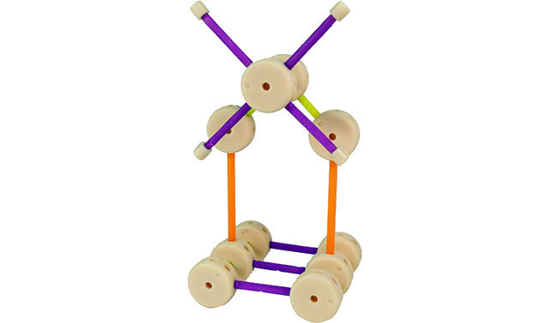
The Designed System
Theories are a system in the same sense
Relate to observed events
Sub theories
Investigation of an airplane crash
Path
Radio communication
Damage type
Nearby objects
Figure 1: Tinker-toy structure
Nodes (circles) and branches (lines)
Interface: inter subsystem communication path
Notes:
Theories are the system in the same sense
They relate to observed events
And they consists of sub theories
For example: If we look at the investigation of an airplane crash each theory has their sub theories of
Plane’s Path, Radio communication, Damage type, Nearby objects
Now let’s look at the Figure 1 from paper. It is a Tinker-toy structure
It has nodes (circles) and branches (lines)
Connections 1,2,3
Also interface which used a lot in system design means Inter subsystem communication path

Slide 13
Relating the Organization and the Design
The design organization - the system designed
System design → Organization structure
"system" to "committee"
"subsystem" to "subcommittee"
"interface" to "coordinator"
Both have several levels.
Example: Government. (laws, policies – Constitution)
Notes:
Basically, we can get organization structure by changing the words in the system design
"system" to "committee",
"subsystem" to "subcommittee" and
"interface" to "coordinator".
Like the systems, design groups contain different levels.
For example Government.
It is a design organization because they design laws, policies.
Also government is a designed system because Constitution (ka) is the first and the most important design document.

Slide 14
Relating the two
Is there an unpredictable relation between the organization communication path and the system that they designed?
Yes.
In fact, sometimes their linear graph is exactly the same.
Proof in the paper:
Choose a random organization and their system designs.
Choose a random level and its equal level
Draw the graphs
Notes:
Is there an unpredictable relation between the organization communication path and the system that they designed?
The answer is Yes.
In fact, sometimes their linear graph is exactly the same.
Let's look at the proof in the paper:
Let's choose a random organization and one of their system designs.
Then let's choose a random level from one of the graphs and its equal level form the other one.
After that, draw the graphs for both.

Slide 15
Proof
Node x in the system → Design group X which designed x
Generalization
For every node of the system
Corresponding node of the design organization
One-to-one or not
Two subsystems → Single design group
Branches ➔ Two nodes: x and y
x and y connected in the system design → X and Y have communications
X and Y agree on interface requirements
Notes:
For any node x in the system we can identify a design group of the organization which designed x.
If we generalize this process,
Every node of the system has a matching node in the organization.
This relationship is not necessarily to be one-to-one.
Two subsystems might have been designed by a single design group.
The same logic implies for the branches as well.
Let's take two nodes: x and y from system design.
If they are connected to each other in the system design, design group X and Y have communications with each other.
That also means X and Y groups agree on interface requirements for two subsystems.

Slide 16
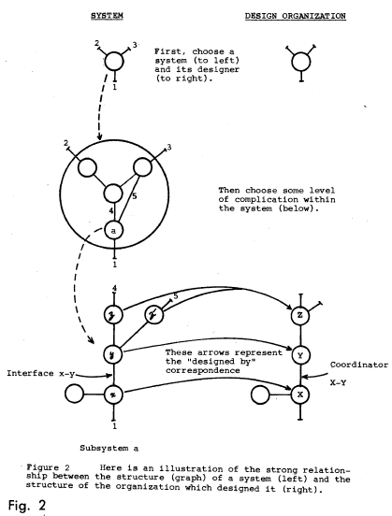
Proof
Notes:
Let’s look at this figure.
System design and organization designs look similar.
The bigger circle is zoomed version.
The lower part is the zoomed version of node a.
You can see the design group X designed x node.
Same goes for y and z.

Slide 17
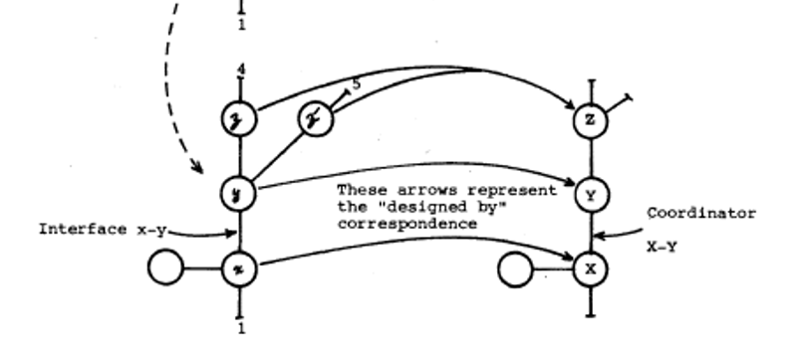
Relating the two
Subsystem - has - design group
Sometimes one group can design more than one subsystem. In that case, design organization node is collapsed version of the system design structure.
Designed subsystems collapsed into one node and shows the designed group.
Notes:
Generally each subsystem has its own separate design groups.
Sometimes one group can design more than one subsystem.
In that case, design organization is collapsed version of the system design structure.
In this figure design group Z designed two subsystems. And the collapsed version of these two represents the design group Z

Slide 18
Relating the two
Relationship between organization chart and system design chart called homomorphism.
Homomorphism: A map between two algebraic structures of the same type (in that case linear graph), that preserves the operations of the structures.
Notes:
- This relationship between two graphs called homomorphism. So we can say there is a homomorphism from the system graph to organization graph.
- Homomorphism: A map between two algebraic structures of the same type (in that case linear graph), that preserves the operations of the structures
- If we traverse system chart with a specific path, we can do the same path on the organization graph as well.

Slide 19

Systems image their design groups
"Someone someday will find a better one to do the same job."
History
It is inaccurate to speak of the design without context of
space
time
knowledge
technology
Notes:
System designers believe that
“Someone someday will find a better one to do the same job".
So why do they believe that?
Because history is full of such examples.
It is inaccurate to speak of the design without context of
space,
time,
knowledge
and technology.

Slide 20


Example
Fortran and Cobol compiler prototypes (mid 1950s) were bulky like their hardware parts.
New transistor designs → new compiler designs
Not as bulky as the Fortran or Cobol compilers
Notes:
Fortran and Cobol compiler prototypes (mid 1950s) were bulky like their hardware parts. (Room sized computers)
With new designs of the transistor, new compiler designs released.
And they were not as bulky as the Fortran or Cobol compilers.

Slide 21
Systems image their design groups
"Family of system designs" which ensures requirements
Design organization structure affects the selection from family
Design structure similar to organization structure
Larger organization → most likely to be similar
Notes:
We can assume that there is a "family of designs" for a system design which ensures requirements.
Design organization structure affects the selection of a design from this family.
Every design that organization makes will be similar to structure of the organization.
And if the organization is bigger, it will most likely to happen in that way.

Slide 22
Examples
"A contract research organization had eight people who were to produce a COBOL and an ALGOL compiler. After some initial estimates of difficulty and time, five people were assigned to the COBOL job and three to the ALGOL job. The resulting COBOL compiler ran in five phases, the ALGOL compiler ran in three."
Two military services
Directed by their Chief
Common weapon system
To meet their needs
Notes:
We have 8 people and we want to build 2 compilers
5 people assigned to COBOL project and 3 people assigned to ALGOL project.
The final COBOL compiler has 5 phases and ALGOL has 3 phases.
Even number of people affects the design of systems.
- Another example.
There are two military services
A chief for both of them
Chief wants to develop a weapon system for each service
They produced a copy of their organization chart.

Slide 23
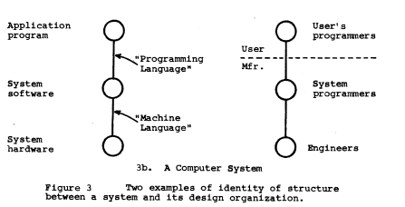
Example
Computer solving a problem
Three parts:
The hardware
The system software (OS)
The application program
Their designers:
The computer manufacturer's engineers
The computer manufacturer's system programmers
User's application programmers
Notes:
Computer solving a problem
Three parts:
The hardware
The system software (OS)
The application program
Their designers:
The computer manufacturer's engineers
Same system programmers
User's application programmers
In manufacturer company hardware and software tend to tolerate each other rather than cooperate

Slide 24

System Management
Larger system
More subsections/subsystems
Split into smaller parts
System management activities
3 reasons why systems tend to disintegrate
Notes:
The larger the system, the more subsections it has.
And larger systems likely to split into smaller parts
This leads to system management actions.
There are 3 reasons why systems tend to disintegrate. These are:

Slide 25
Reasons
Initial designers can assign too many designers to the project if they thought the system will be large. Also organization pressure affects these decisions too.
Larger organizations’ communication path tends to disintegrate due to traditional management decisions. They don't have enough flexibility in design organization structure.
Organization is large and has a disintegrated structure. We mentioned that there is homomorphism between two charts. Therefore, design structure will be split into parts.
Notes:
If the initial designers thought the system will be large, they tend to assign too many people to design. Pressures from the organization affects these decisions too.
Due to the management decisions, larger organizations tend to disintegrate. Also they don’t have enough flexibility in organization structure.
Larger organizations has disintegrated structure. Since these two graphs has homomorphism between them, system design structure will disintegrate.

Slide 26

Why initial designers assigns too many people to the project?
Large and complex projects
Initial designers
deal with difficulty → try to reduce
lose control
Time and budget pressure
Split the project into too many parts
Managers want to use all of their resources.
Another pressure → Not risk it, overpopulate
Notes:
When the project is large and complex,
initial designers either deal with it and try to reduce the difficulty or they lose control of it.
With time and budget pressure, initial designer most likely to split the project into too many parts.
The other reason for that is managers.
Generally, they want to use all of their resources (in that case it's people).
This creates another pressure on the initial designers and instead of risking it, they assign all the people.

Slide 27
Management Example
“A manager must subcontract a crucial and difficult design task. He has a choice of two contractors, a small new organization which proposes an intuitively appealing approach for much less money than is budgeted, and an established but conventional outfit which is asking a more "realistic" fee. He knows that if the bright young organization fails to produce adequate results, he will be accused of mismanagement, whereas if the established outfit fails, it will be evidence that the problem is indeed a difficult one.”
Notes:
Let’s look at management example
A manager must subcontract a crucial and difficult task
He has two options
A small and new organization for less money
Or established and larger organization with realistic fee
If he choses small organization and they fail, he will be accused of mismanagement
But if he choses the established organization, that will be an evidence to the problem’s difficulty

Slide 28

Why initial designers assigns too many people to the project?
Accounting theory → resource unit = $
Linearity
2 men, 30 days = 30 men, 2days
Different designs (Homomorphism)
Value wouldn’t the same
Manager with budget and power
Increase # people
Overpopulation → Worse design
Notes:
Traditional accounting theory states that resource unit is the dollar.
All other resources can be converted to the dollar.
But this theory uses linearity.
For example: 2 men working for a month and 30 men working for a 2 days
are equal within this theory (same wage).
However, homomorphism states that their designs will be different
and that means their value would not be the same.
Another reason for assigning too many people is managers with enough budget and power,
They tend to increase the number of people who works with them.
And this will cause worse system designs than before.

Slide 29
Organization Communication
Another important aspect for system disintegration
Number of communication path ~ (#people)²/2
Block the communication path → "work"
Management sets numerical constraints on the organization graph
Military organization structure
1 superior
~7 sub nodes
Similar design structures
Notes:
The communication in the organization structure is another important aspect to why systems disintegrate.
Approximate number of communication path in an organization is (x^2)/2.
But organizations tend to block the communication path in order to “do work".
Generally, management sets numerical constraints on the organization graph like in military.
For example: military organization structure has one superior and 7 sub nodes.
At the end of the they their system designs very similar to this structure.

Slide 30

Conclusion
"Organizations which design systems are restricted to produce designs which are copies of the communication structures of their organization."
If the design management is not flexible enough to organize the design groups’ communication, system design will disintegrate more.
Notes:
If we summarize the presentation, we could get these points.
"Organizations which design systems are restricted to produce designs which are copies of the communication structures of these organizations."
If the design management is not flexible enough to organize the design groups communication, than system design will disintegrate more.

Slide 31
Conclusion
First design concepts → not the best ➔ change
New communication ways in the design organization
Flexible for new design concepts
No communication + adding manpower ≠ productivity increase
In fact, it might even decrease it
Notes:
First design concepts will never be the best ones.
They need to change.
Therefore, new communication ways in the design organization should be allowed.
Design managers have to keep their design teams flexible for new design concepts.
If there is no communication between groups,
adding more manpower does not increase the productivity of the project.
In fact, it might even decrease it at some point.

Slide 32
Thank you!

Slide 33
References
http://www.melconway.com/Home/Committees_Paper.html
http://www.melconway.com/Home/pdf/committees.pdf
https://en.wikipedia.org/wiki/Melvin_Conway
https://www.wikiwand.com/en/Conway%27s_law
The New Industrial State
Bus: Photo by Mario Sessions on Unsplash
Plane: Photo by Gary Lopater on Unsplash
Train: Photo by Ankush Minda on Unsplash
Parking lot: Photo by John Matychuk on Unsplash
Taxi: Photo by Jesse Bowser on Unsplash
Bus stop: Photo by Dele Oke on Unsplash
Time: Photo by Agê Barros on Unsplash
System Management (Paper): Photo by Isaac Smith on Unsplash
1 Dollar: Photo by NeONBRAND on Unsplash
Coffee & Keyboard: Photo by Leone Venter on Unsplash
Notebook: Photo by ASHLEY EDWARDS on Unsplash
Images
Design: Photo by Edho Pratama on Unsplash
System: Photo by Clint Adair on Unsplash
Money: Photo by Pepi Stojanovski on Unsplash
Stages of Design: Photo by Alvaro Reyes on Unsplash
Lifecycle: Photo by Kelly Sikkema on Unsplash
Designed system (Tree): Photo by Fabrice Villard on Unsplash

